Slide 1
1.0 Review of AC Circuits
EE1203 – Theory of Electricity
Prof J. Rohan Lucas
lucas@kdu.ac.lk
Department of Electrical, Electronic & Telecommunication Engineering
General Sir John Kotelawala Defence University
July 2020
Notes:
Today, you will listen to my recorded presentation on the topic “AC Circuits” in the module Theory of Electricity.
This is an examinable module, and this lecture will be considered as part of the delivered lectures for the module.
I will try and record this module to be as close as possible to a live lecture in the classroom. However, you will not be able to ask online questions “but” get clarifications from me by an email.

Slide 2
Learning Outcomes
On completion of module, student will be able to LO1: Analyse the performances of AC circuits using nodal and mesh analysis. LO2: Analyse 2 port networks using different models. LO3: Analyse RLC networks for transients. LO4: Analyse waveforms for its harmonics. LO5: Perform calculations in three phase circuits including the unbalanced waveforms.
t
Notes:
.

Slide 3
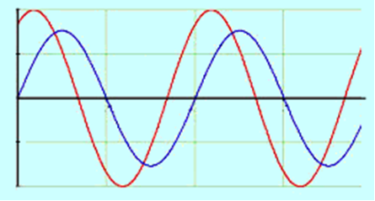
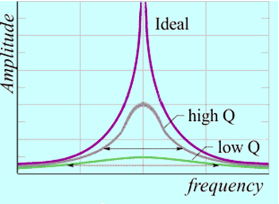
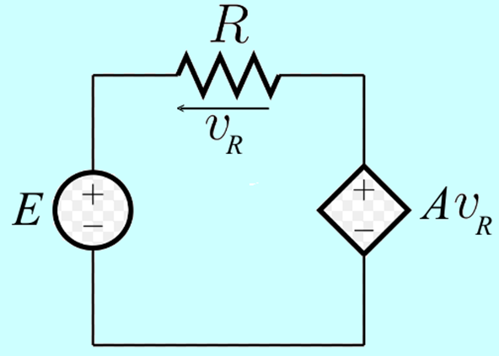
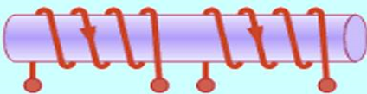
AC Circuit analysis (15 hrs)
Review of basic components and AC theory Series and parallel resonance Electromagnetic coupling: Mutual inductance Analysis of coupled circuits: Transformer. Dependent sources: solving circuits
t
Notes:
.

Slide 4
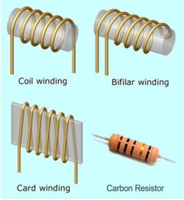
Review of electric components
Resistance (unit: ohm, Ω; letter symbol: R, r)
R
R
i(t)
v(t)
(a)
(b)
(c)
Figure 1 – Circuit symbols for Resistance
v = R i, i = G v
p(t) = v(t) . i(t) = R . i²(t) = G . v ²(t)
w(t) = ∫ v(t) . i(t).dt = ∫ R . i²(t). dt = ∫ G. v ²(t).dt

Slide 5
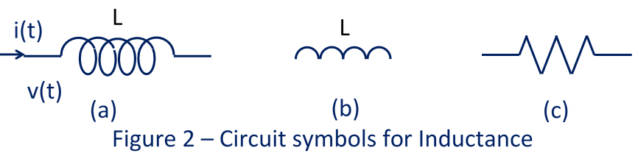
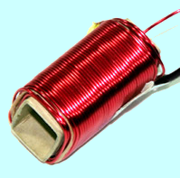
Inductance (unit: henry, H; letter symbol: L , l )
v = Lp i, i = v/Lp
Current through inductor cannot change suddenly.
p(t) = v(t) . i(t)
w(t) =∫ v(t).i(t).dt =
= ∫L.i.di = ½L.i²

Slide 6
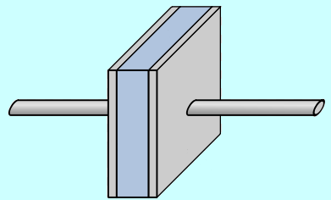
Capacitance (unit: farad, F; letter symbol: C, c )
i(t)
C
C
v(t)
(b)
(a)
Figure 3 – Circuit symbols for Capacitance
v = (1/Cp) i, i = Cp v
Voltage across capacitor cannot change suddenly.
p(t) = v(t) . i(t)
w(t)=∫v(t).i(t).dt =
= ∫ C.v.dv = ½C.V ²

Slide 7
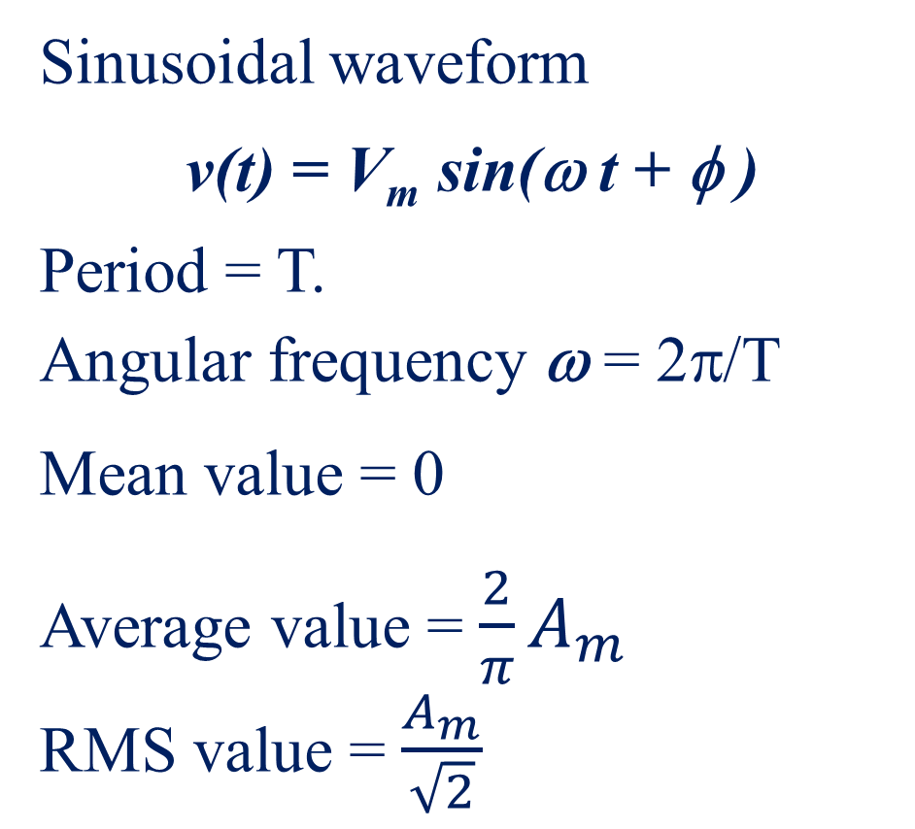
Review of AC theory
Sinusoidal waveform
v(t) = V_{m} sin(ω t + φ )
Period = T.
Angular frequency ω = 2π/T
Mean value = 0
Average value = $\frac{2}{π}A_{m}$
RMS value = $\frac{A_{m}}{\sqrt{2}}$
v(t)
T
t
T

Slide 8
Review of Phasor Representation
e ^{jθ} = cos θ + j sin θ or e ^{jωt} = cos ωt + j sin ωt
Sinusoidal waveform is the projection of complex exponential e^{jωt}.
P
a(t)
A_{m}sin (ω t+φ)
ω
R
φ
ω t
0
X
0
t
A_{m}
P
φ
0
R
Rotating Phasor diagram
T
A reference direction is chosen, usually horizontal.
A_{m}
P
φ
A_{y}
φ
0
A_{x}
reference direction
0
R
Phasor diagram

Slide 9
Phasor
Characterised by
Magnitude ⎪A⎪ and phase angle φ
Polar co-ordinates ⎪A⎪∠φ
Cartesian co-ordinates A_{x} + j A_{y}
A_{y}
φ
0
A_{x}
Phase difference
φ₂− φ₁
y(t)
B_{m}
B_{m}sin (ω t+φ₂)
ω
A_{m}sin (ω t+φ₁)
A_{m}
φ₁
O
φ₂
φ₂− φ₁
ωT

Slide 10
Phase Difference
(1) Resistor
V = R . I with rms values
I
R
Phasor diagram
O
I
V
V
(2) Inductor
V = jωL.I = ωL.I∠90^{ο}
I
L
Phasor diagram
O
V
V
I
(3) Capacitor
I
C
I
V
O
V
Phasor diagram
V = .I = . I∠-90º

Slide 11
Impedance and Admittance in an a.c. circuit
Impedance Z is a complex quantity.
Relates complex rms voltage to complex rms current.
V = Z . I
Admittance Y is inverse of impedance Z.
I = Y . V
In cartesian form
Z = R + j X and Y = G + j B
Real part of Z is resistive, usually denoted by R,
Imaginary part of Z is called a reactance denoted by X.
Real part of Y is a conductance, denoted by G,
Imaginary part of Y is a susceptance, denoted by B

Slide 12
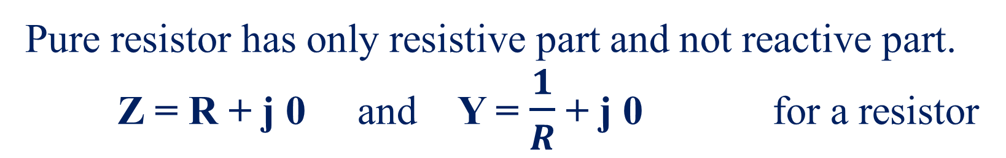
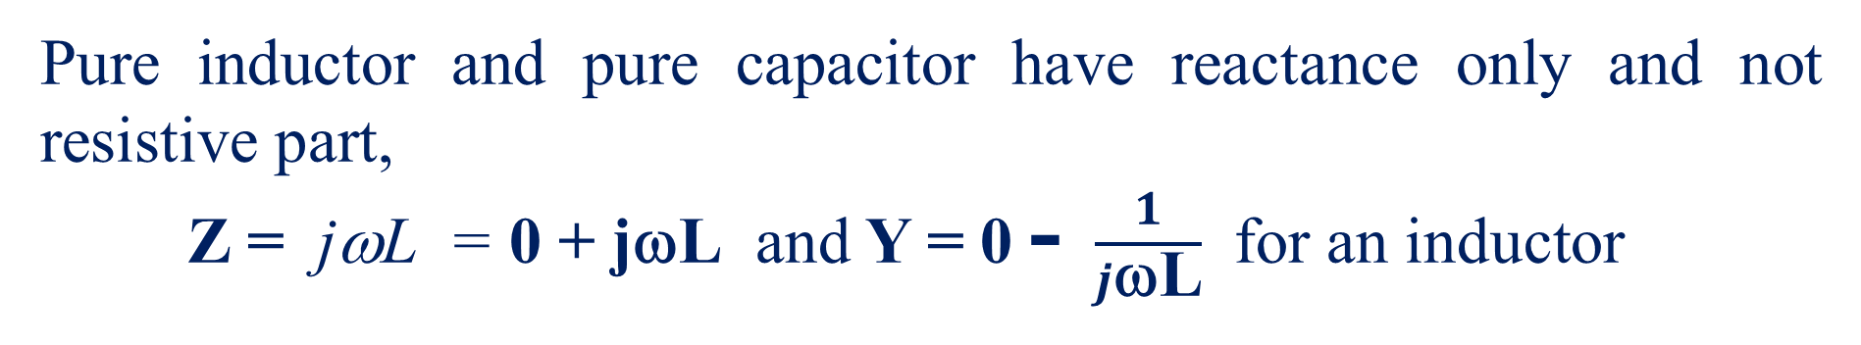
Impedance and Admittance for R, L and C
Pure resistor has only resistive part and not reactive part.
Z = R + j 0 and Y = $\frac{1}{R}$ + j 0 for a resistor
Pure inductor and pure capacitor have reactance only and not resistive part,
Z = jωL = 0 + jωL and Y = 0 - $\frac{1}{j\text{ω}\text{L}}$ for an inductor
and Z = = 0 – j and Y = 0 + jωC for a capacitor

Slide 13
R-L series circuit
V_{R} = R.I, V_{L} = jωL.I,
and V = V_{R} + V_{L} = (R + jωL).I
Z = R + jωL
V_{R} is in phase with I,
V_{L} is leading I by 90º.
By phasor addition, V = V_{R} + V_{L}.
V
jωL
R
I
V_{R}
V_{L}
V
φ
V_{L}
In R-L circuit,
current I lags voltage V by an angle less than 90º and the circuit is said to be inductive.
Power dissipation only occurs in resistive part of circuit and as R.I ²
I
V
V_{R}
V_{L}
V_{L}
Phasor diagram
φ
I
V_{R}
Phasor diagram

Slide 14
R-C series circuit
V_{R} = R.I, V_{C} = .I
and V = V_{R} + V_{C}
∴ V = (R + .I
I
V_{R}
V
φ
R
I
V
V_{C}
V_{R}
V_{C}
V_{R}
so that Z = R +
I
φ
V_{C}
Phasor diagram is drawn with V (or I) as reference.
In R-C circuit, current I leads voltage V by an angle less than 90º and the circuit is said to be capacitive.
V
Power dissipation can only occur in the resistive part of the circuit and is equal to R.I ², not equal to product V. I.

Slide 15
L-C series circuit
V_{L} = jωL.I
V_{C} = .I = - j
and V = V_{L} + V_{C}
∴ V = (jωL + ).I
Z = jωL + = jωL – j
V
jωL
I
V_{C}
V_{L}
V_{L}
V_{L}
V_{C}
V
or
V
I
I
V_{C}
Phasor diagram
All voltages are inphase but perpendicular to current I.
Resultant voltage could be either up or down depending on which voltage V_{L} or V_{C} is more.

Slide 16
R-L-C series circuit
V
jωL
R
I
V_{L}
V_{R}
V_{L}
V_{C}
V
V_{R} = R.I, V_{L} = jωL.I, V_{C} =
V = V_{R} +V_{L} + V_{C} = (R + jωL + ).I
Z = R +jωL + = R + j(ωL – )
φ
V_{C}
V_{L}+V_{C}
I
V_{R}
Phasor diagram
Magnitude has minimum value at ωL = −

Slide 17
Active Power and Apparent Power
In an a.c. circuit, active power P
is commonly referred to as Power, unless otherwise stated
is consumed only in resistive parts of circuit
in general is not equal to product V . I
in purely inductive parts and purely capacitive parts of a circuit active power is zero.
To account for apparent discrepancy, we define
apparent power S = V . I

Slide 18
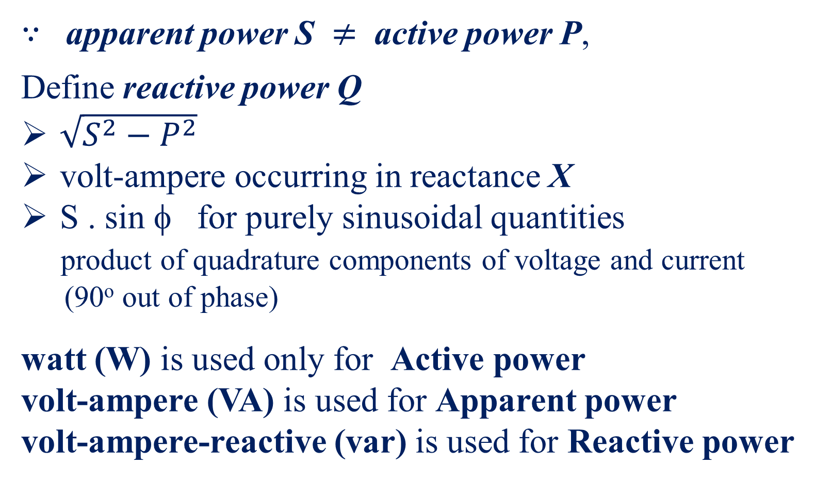
Reactive Power
$∵$ apparent power S $≠$ active power P,
Define reactive power Q
$\sqrt{S^{2}−P^{2}}$
volt-ampere occurring in reactance X
S . sin φ for purely sinusoidal quantities
product of quadrature components of voltage and current (90º out of phase)
watt (W) is used only for Active power
volt-ampere (VA) is used for Apparent power
volt-ampere-reactive (var) is used for Reactive power
S
Q
φ
P
∵

Slide 19
Intantaneous power p(t) with time varying quantities
Instantaneous value of power is given by p(t) = v(t) . i(t)
If v(t) = V_{m} cos ω t and i(t) = I_{m} cos (ω t − φ),
where voltage is reference and current lags voltage by phase angle φ.
Then p(t) = V_{m} cos ω t . I_{m} cos (ω t − φ)
= V_{m}I_{m} .½. 2 cos ω t . cos (ω t − φ)= ½V_{m}I_{m} [cos (2ω t − φ) + cos φ]
v(t)
p(t)
p(t)
i(t)
½ V_{m} I_{m}
p(t)
½ V_{m} I_{m} cos φ
0
t
t
t
T
current lagging voltage by angle φ inphase quadrature

Slide 20
Power Factor
Waveform of power p(t) has a sinusoidally varying component and a constant component.
Average value of power (active power) P would be given by the constant value ½ V_{m} I_{m} cos φ.
P = ½ V_{m} I_{m} cos φ = = V . I cos φ
For sinusoidal quantities, power factor (p.f.) = cos φ
For a resistor, φ = 0º, p.f. = 1, so that P = V . I
For an inductor, φ = 90º lagging, p.f. = 0, so that P = 0
For an capacitor, φ = 90º leading, p.f. = 0, so that P = 0

Slide 21
Power factor angle
For resistor,
P = V. I
Power factor angle φ = 0º, reactive power Q = 0
For inductor or capacitor,
V. I exists although P = 0
Power factor angle φ = ±90º, reactive power Q = V. I
Unlike inphase, where same direction means positive, with quadrature, there is no natural positive direction.
For combinations of resistor, inductor and capacitor,
P lies between V. I and 0 and p.f. between 1 and 0.

Slide 22
Convention for Reactive Power
Usual to define
Inductive reactive power
when current lagging voltage
Capacitive reactive power
when current leading voltage.
Inductive reactive power and capacitive reactive power have opposite signs.
φ
V
I
I
V
φ

Slide 23
Power factor correction
P₁
With p.f. < 1, for same power transfer P the current required becomes larger and the power losses in the circuit becomes still larger (power loss ∝ I²).
φ₁
Q₁
For a load with lagging power factor cos φ₁
active power P₁, reactive power Q₁
If power factor is improved to a new value cos φ₂ ( >cos φ₁)
leading reactive power Q_{c} must be added.
usually done by using capacitors.
P₁
φ₁
φ₂
Q₂
Q_{c}
Q₁
With pure capacitors, active power is unchanged at P₁, assuming supply voltage remains unchanged.
Thus new reactive power Q₂ = Q₁ – Q_{c}
Notes:
Although reactive power does not consume any energy, it reduces the power factor below unity.
Thus supply authorities encourage industries to improve their power factors to be close to unity.

Slide 24
Calculation of required capacitor for correct power factor
What is known is P₁, cos φ₁ and cos φ₂.
Thus Q₁ = P₁ tan φ₁ and Q₂ = P₁ tan φ₂
so that Q_{c} = Q₁ – Q₂ = P₁ tan φ₁ − P₁ tan φ₂
Reactive power supplied by a capacitor is dependant on its capacitance C and its voltage V.
Thus Q_{c} = P₁ tan φ₁ − P₂ tan φ₂ = V².Y = V².C ω
The rating of the capacitor can be given as Q_{c}
Or the value of C can be determined from V².Cω = Q_{c}
P₁
φ₁
φ₂
Q₂
Q_{c}
Q₁

Slide 25
Example on Power factor correction
A 240V, 50Hz supply feeds (i) a load of 40 +j 30 Ω, and (ii) a single phase motor of 2 kW at a power factor of 0.65 lag.
(a) Determine the active power and the reactive power taken by the combination of the two loads.
(b) What should be the rating of the capacitance to be added to correct the power factor to 0.95 lag?
i
i₁
i₂
240V
50Hz
40+j30Ω
2 kW
p.f. 0.65 lag
M

Slide 26
Answers
P
i
i₁
i₂
240V
50Hz
Q_{new}
2 kW
p.f. 0.65 lag
M
40+j30Ω
Q_{cap}
i = i₁ + i₂ = 12.82∠−49.46⁰ + 4.8∠−36.87⁰ = 17.54∠− 46.03⁰ A
Q
at supply power factor = cos(46.03⁰) = 0.694 lag
active power = 240×17.54×0.694 = 2.92 kW (also P = 2000+4.8²×40)
reactive power = 240×17.54×sin(46.03⁰) = 3.03 kvar
with p.f. 0.95 lag → 18.19º, new reactive power = 2.92×tan 18.19º = 0.96 kvar
Rating of capacitor Q = (3.03 – 0.96) = 2.07 kvar
[or value of capacitor C = 2.07×10³/(240²×100π) = 114.4 μF]

Slide 27
Recap of Lecture
Review of basic electrical components
Review of ac theory
Notes:
You have now listened to my recorded presentation on the topic Review of basic electrical components and the review of ac theory in the section Alternating Current Circuits in the module Theory of Electricity.
Hope you were able to follow the lectures.

